Slide 1
Business 101 Workshop Analysis
Evan Henley and Lara Bamberger

Slide 2
Basic Participant Information
Total sign-ups who actually attended the workshop: 20/38 or 52.6%
Those referred who actually attended: 4/30 or 13.3%

Slide 3
ProsperUs Specific Analysis
Overall, students are very satisfied with ProsperUS and have developed a deeper understanding of its mission.

Slide 4
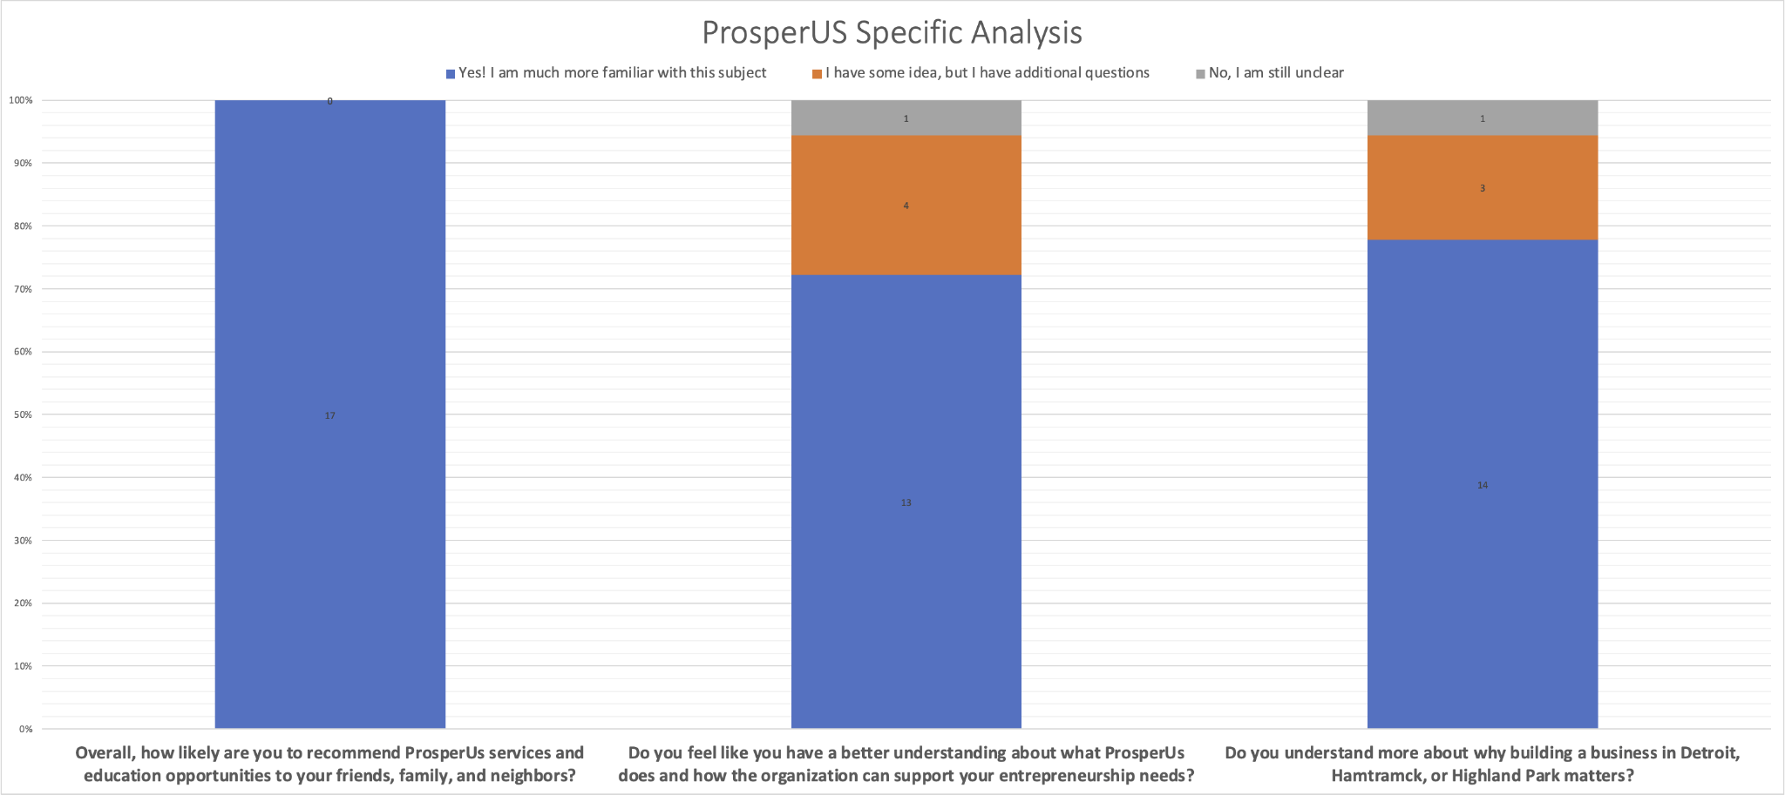
Notes:
Color matching on top left

Slide 5
Basic of Business Feedback
Overall, students developed a much stronger understanding of starting a business, general business models, overcoming obstacles as entrepreneurs, and other basics of business.

Slide 6
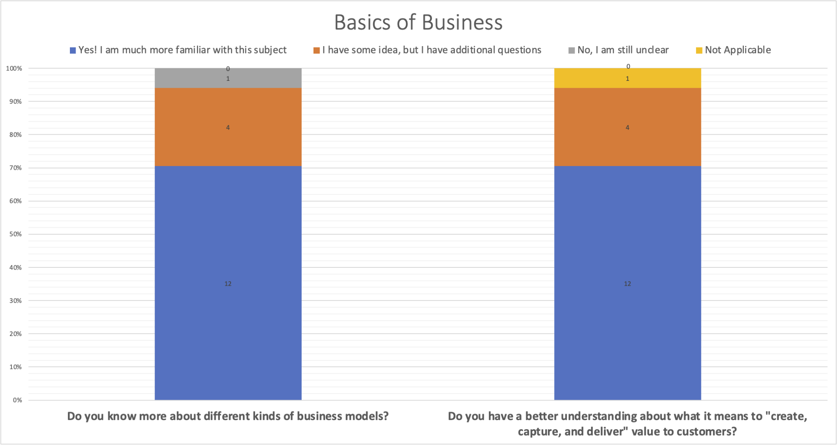
Notes:
I am still unclear different color than not applicable , ma

Slide 7
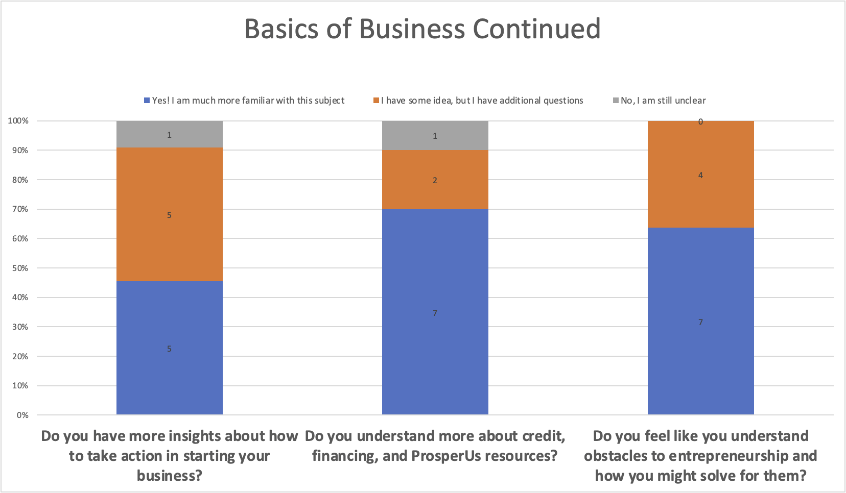
Notes:
Note the color flip. Although students definitely seemed excited about ProsperUS, its mission, and have the drive to start their own business, they remain a bit confused on what specific actions they can take from the workshop to apply to their business. Seemingly, this arises from the challenges of technical concepts.

Slide 8
Advanced Business Topics
With some of these more advanced, complex business topics, all participants greatly benefited by becoming more familiarized with the topics, but we found that more participants felt that they had lingering questions and were still a little unclear.

Slide 9
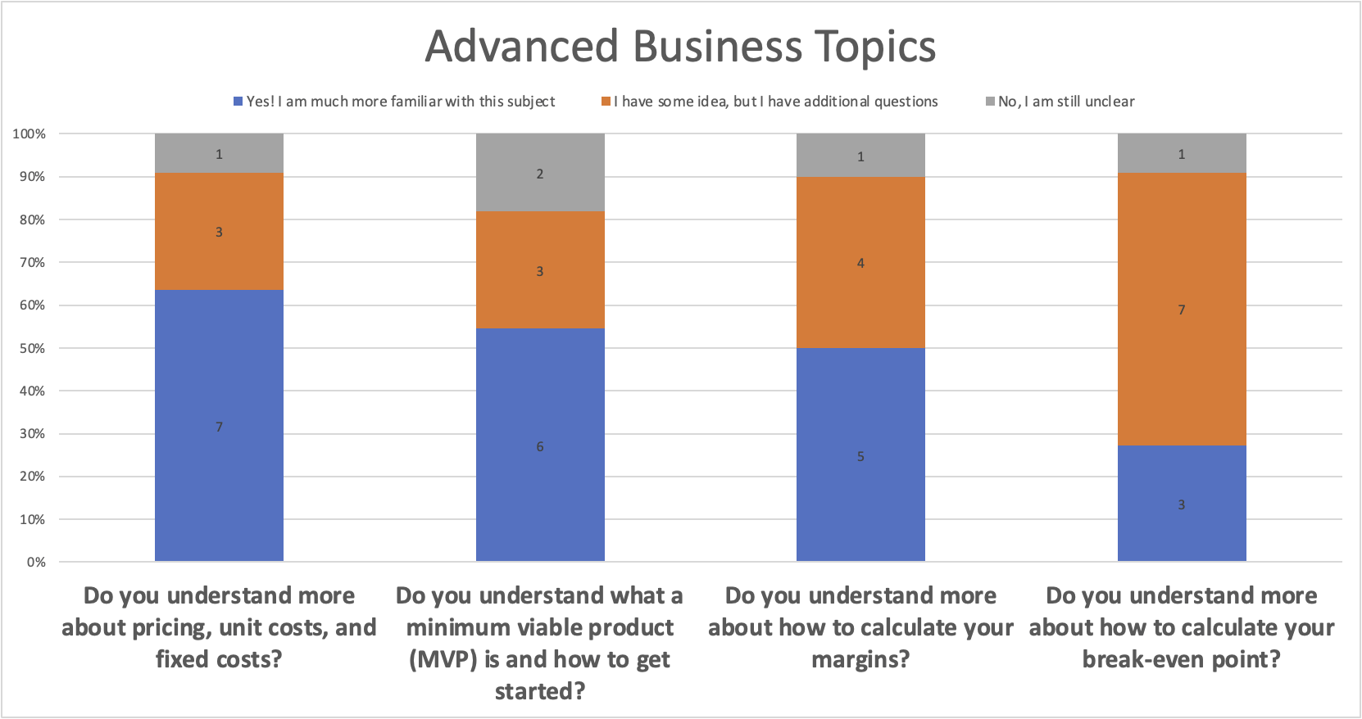

Slide 10
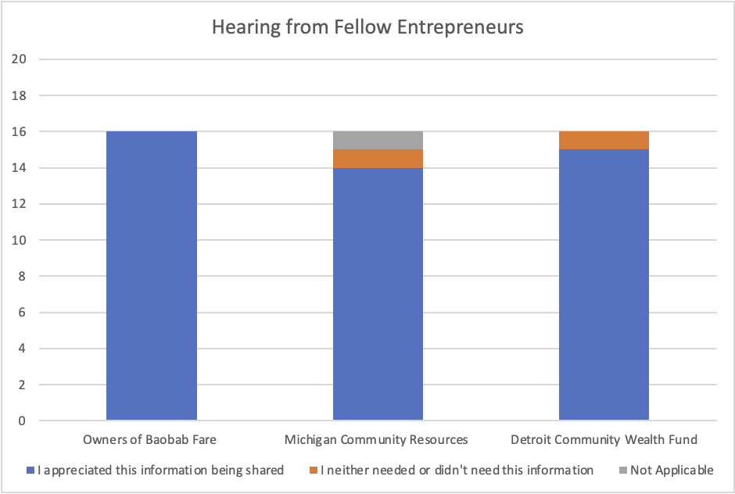
Listening to Entrepreneurs
Students enjoyed listening to various owners of businesses
Notes:
Although it seemed that some students struggled to find directly transferable concepts, almost all of them enjoyed hearing from successful entrepreneurs.

Slide 11
Glows
Drove people to a deeper understanding of ProsperUs’s mission
Inspired participants to be even more passionate about helping their community
Students enjoyed hearing from fellow entrepreneurs as well as various community resources
The majority of students gained a thorough understanding of almost all of ProsperUs’s teaching goals

Slide 12
Grows
Length: there was consistent feedback that the workshops were on the longer side.
Focus/Understanding: Most people had a much stronger understanding on the more general, basic business information than some of the more complex, nuanced business principles.

Slide 13
Recommendations
Length: We recommend dividing the sessions into 3-4 shorter sessions, especially when held in the virtual environment.
Review: We recommend sharing the recording if everyone feels comfortable with this, and if not sending out the presentation and other materials provided.
Follow Up: With the follow up survey, we recommend giving the participants the option to set up one-on-one follow ups to review concepts they want to further discuss.
Focus: We recommend that more time and focus is dedicated to the more complex, nuanced business principles so that the entrepreneurs can take away more actionable steps.

