Slide 1
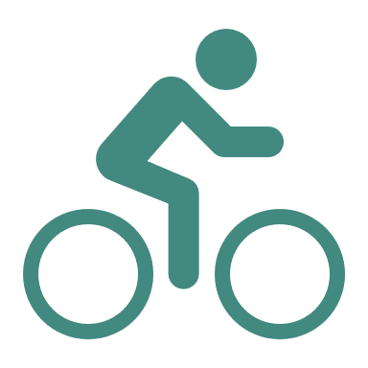
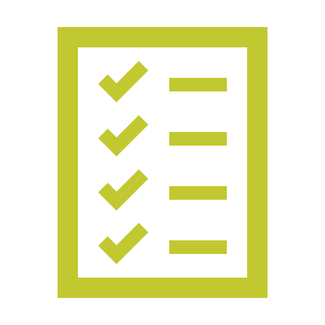
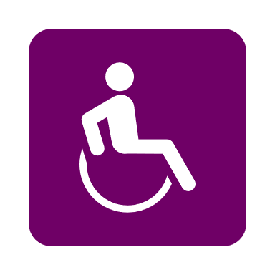
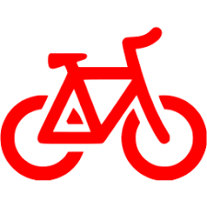
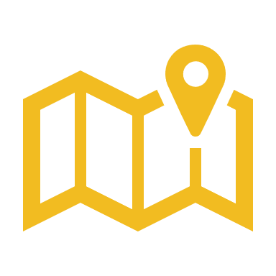
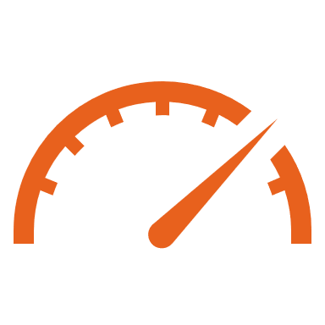
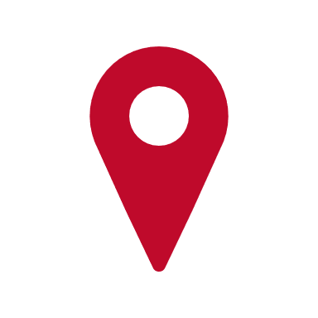
MoGo Timeline
Idea Takes Root
Feasibility Study
MoGo Becomes a Nonprofit
Business and community leaders meet for the first time to explore the possibility of bike share
In 2013, Wayne State University conducts a feasibility study, serving as the road map for implementing bike share in Detroit
MoGo receives 501(c)3 status and becomes a nonprofit affiliate of the Downtown Detroit Partnership
2012
2013
2015
2017
MoGo Surpasses 100,000 Trips
MoGo Launches
MoGo Passes For Sale
In May 2017, MoGo launched with 43 stations and over 430 bikes ready
April
MoGo surpasses first year ridership goal in less than five months
All MoGo pass options are available for sale to public
2018
Oct
May
2012-2019
May
Adaptive MoGo
Launched in May 2018, Adaptive MoGo offers cycling options for riders of all abilities, including recumbent tricycles, upright cargo tricycles, hand tricycles, tandem bicycles, etc.
5,000 Member Passes Sold
MoGo North Expansion
MoGo surpasses 5000 memberships sold by the start of 2019
TBD
Oct
2019
July
2020
MoGo Adds 44th Station
MoGo Boost
MoGo adds its first non-kiosk station at Rosa Parks Blvd & Michigan Ave
MoGo Boost, a pedal-assist e-bike series, launches in July 2019

