Slide 1
Pauline Grieb and Thomas Wang
Duke Engage Detroit June-July 2017

Slide 2
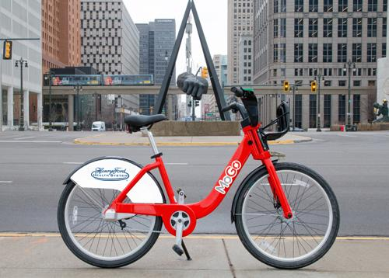
What is MoGo?
Detroit’s 1st public bike share system
Network of 430 on-demand bicycles at 43 self-serving stations in 10 Detroit neighborhoods
Gives people 24/7 365 access to affordable transit that can get them to their destination
On the forefronts of accessible bike share
$5 Annual Access Pass
Cash payment option
Adaptive Bike Share pilot program
MoGo Street Skills Classes
Neighborhood/ Youth Ambassador Program
Notes:
MoGo is a pioneer of accessible bike share

Slide 3
What did we do?
Main Project: Evaluation Plan
Established a framework to gather quantitative and qualitative data about MoGo for a 2017 annual report
Created surveys (Annual, Intercept surveys…)
Established a timeline to deploy evaluation strategies (data analysis, conducting surveys)
Additional Projects:
Helping out with Community Outreach Events
MoGo/ DXF Tour
Organized info session at MUFI (Michigan Urban Farming Initiative)
Notes:
in different sections from Demographics, Trip evaluation to Environmental Impact
Created variety of surveys-Annual (bulk of data) but also surveys for local businesses/ bike advocates + intercept surveys (which we tested out+developed a framework for volunteer structure)
Timeline
Additional projects:
-community outreach events (Clark Park event, Mighty MoGo Rider Challenge)
-MoGo/DXF tour -logistics, thinking about landmarks along the way → downtown/corktown
-MUFI info session -important to have cohesive environmentalism

Slide 4
What we accomplished!
Developed an Evaluation Plan for MoGo
Helped organize Mighty MoGo Rider Challenge
Helped organize Adaptive Bike Share Community Feedback Event
Researched how other bike share programs are visualizing data
Distance analysis of MoGo stations to other public transit hubs
Worked on some featured bike routes for the MoGo website
Notes:
-Glimpse of evaluation plan
-brainstorming sessions: think through logistics of Mighty MoGo Rider challenge

Slide 5
Thank you
&
Notes:
We would like to thank Lisa, Rory and Adriel at MoGo for welcoming us onto the MoGo team for the summer and for giving us the unique opportunity to discover the multifaceted world of bike share!

